Slide 1
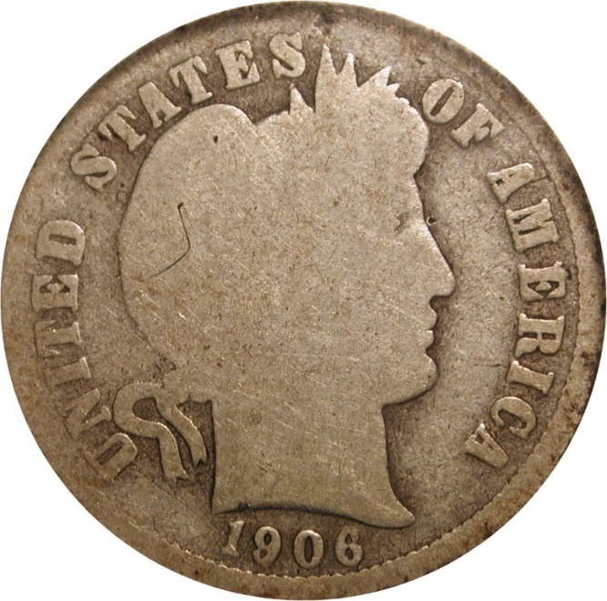
Discovery of the 1906-D/O Barber Dime
Notes:
This presentation highlights the discovery of an interesting new variety for the Barber Dime series, the 1906-D/O.

Slide 2
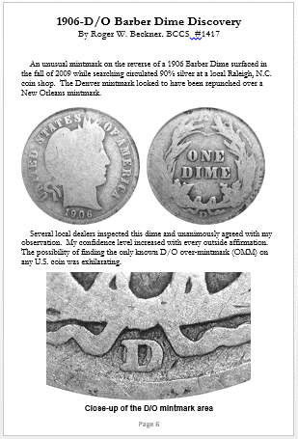
Discovery of the 1906-D/O Barber Dime
At the Raleigh Coin Club’s Annual Show in June 2015
New BCCS Member Roger Beckner brought a coin to the club’s table
Fantastic and indisputable discovery
I had my camera with me to take photos
I asked Roger to write a few paragraphs to accompany the photos
Presto! Article for the Journal!
And now a new short presentation!
Notes:
This story is a great example of how an interesting article or presentation can come to light.
At the June 2016 Raleigh Coin Club Annual show, the BCCS had a club table to promote the club, meet other Barber collectors, and to exhibit some neat Barber material for show attendees.
Seeing the BCCS table, Barber collector Roger Beckner came over to say hi. After discussing the club, looking at the exhibits, Roger ended up joining the BCCS.
Later he came back with one of his prized Barbers – a slabbed 1906-D dime that had a clear O beneath the D mintmark. Something we had never seen before. He told this story, and brought in the supporting materials on the discovery.
We had a camera at the table, and asked if we could take photos of the coin, and the other materials documenting this fantastic discovery. He happily agreed, as he had not yet obtained quality photos for himself.
Once the photos were shared, Roger agreed to write up a few paragraphs about the discovery that could be turned into an article for the BCCS Journal. He agreed, and the article appeared in the Journal during the fall of 2015 (Volume 26, #3).
From this article, using the same photos, we now have this short presentation on this remarkable coin!

Slide 3
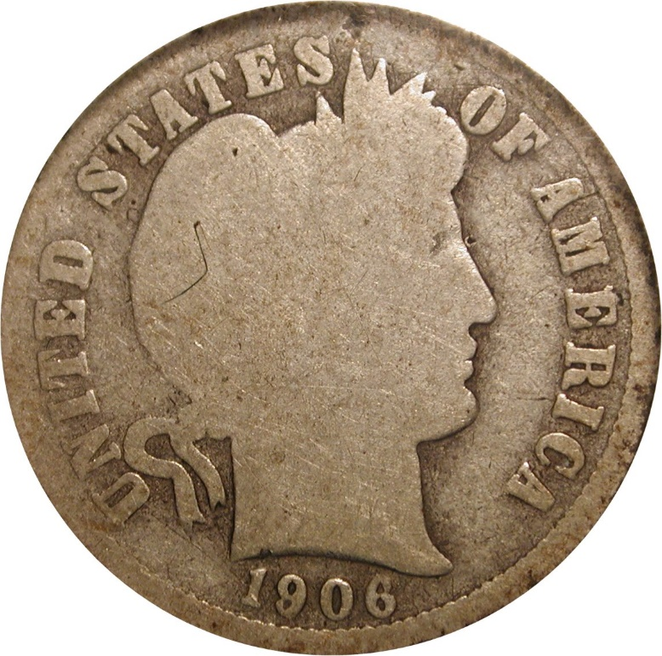
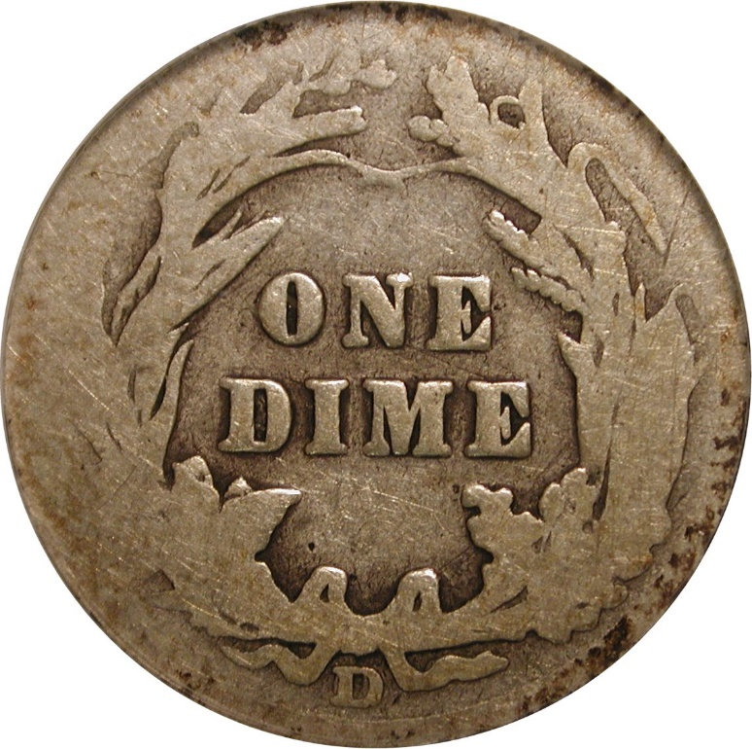
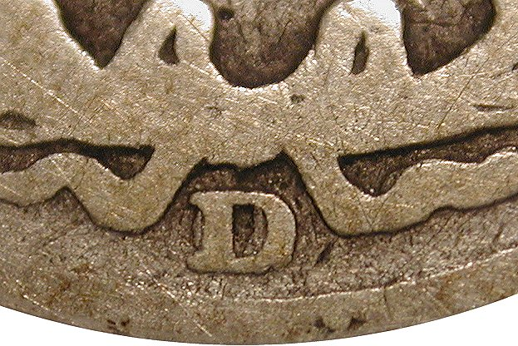
1906-D/O Barber Dime – The coin
Low grade example
Mintmark area clear and strong
Notes:
Here is the coin itself. As you can easily see, the dime is in low grade, just shy of full Good. It was graded AG3.
Looking at the mintmark, even though the coin is in low grade, the Over-Mintmark is clear. The inside curve of the O is plainly visible within the inside of the D, and the left outer curve of the O is also clear to the left of the D.
It doesn’t appear that is a D/D, because of the left side, and this area is sharply defined.
At this point, Roger described the process of getting this variety recognized for what it is.

Slide 4
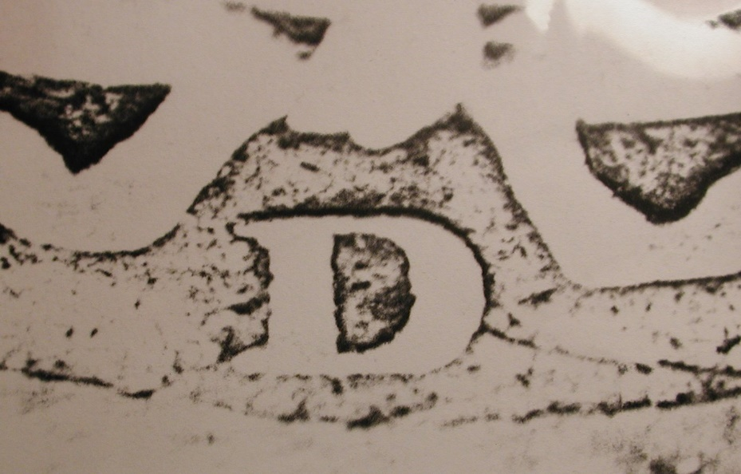
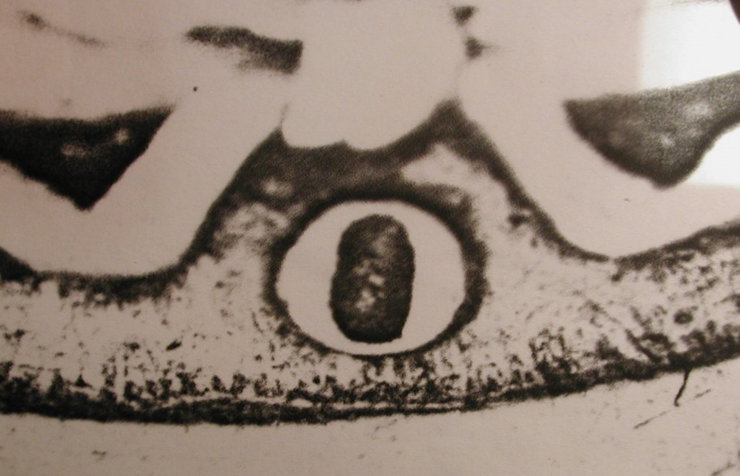
1906-D/O Barber Dime – Investigation
With controversy on 1909-O over inv D, need validation
Coin sent to Bill Fivas for opinion
He created transparencies of D and O mintmarks from photos of other coins
D Transparency
O Transparency
Notes:
Roger wanted validation of the new variety, This is important because a well-known variety, the 1909-O over inverted D, has become somewhat controversial, and is not universally recognized, as there is significant doubt as to what it is. Most people now believe that it actually is simply a 1909-O/O, just a repunched mintmark, and not a true over-mintmark with two different letters.
Roger went to well-known variety expert Bill Fivas, co-author of the Cherrypickers Guide of Rare Varieties, for his opinion. Bill also thought it as a D over O, and to support his belief, he performed some simple tests.
He photographed the mintmark areas of two different Barber dimes, one with a D and the other with an O mintmark. He converted these photos into transparencies which could be overlaid on each other.
When he placed the two transparencies on top of each other, he got the result he was expecting. An exact match with the new coin.

Slide 5
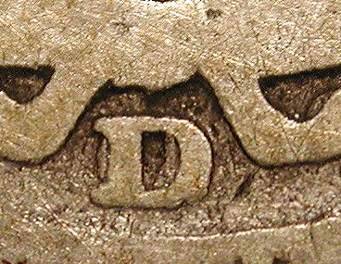
1906-D/O Barber Dime –Confirmation
The transparencies allowed an overlay comparison
Only one conclusion is possible
Overlay of Transparencies
Matching D/O
Notes:
Comparing the overlay of the transparencies with the coin, the result is quite clear. The shapes of the curve inside the D, and the curve to the left of the D, match the O.
In a letter that Bill Fivas wrote to Roger, he confirmed his opinion that it was indeed a D over O, and saying “there is no doubt in my mind”

Slide 6
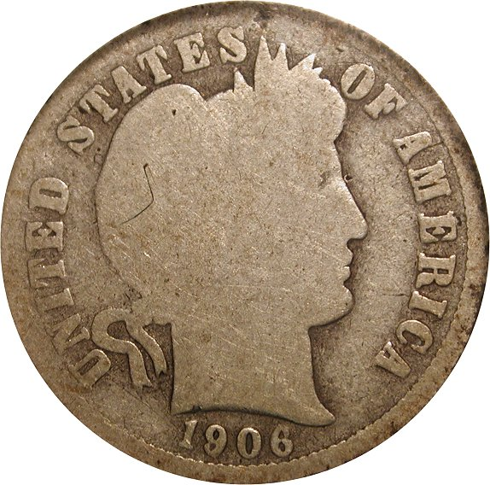
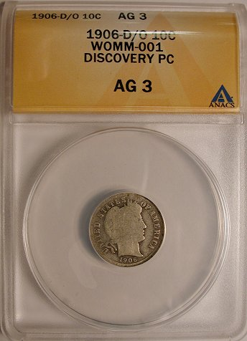
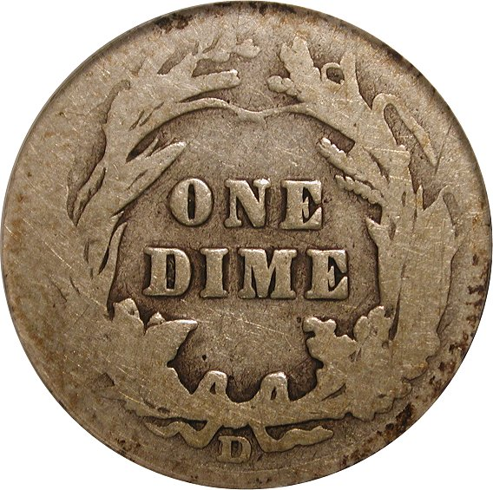
1906-D/O Barber Dime – Discovery Piece
Notes:
Based on Bill Fivas’ confirmation, ANACS certified this new variety as an Over Mintmark, and listed it as the discovery piece.
As of the beginning of 2016, this is still the only known example. As the Over Mintmark is fairly obvious with a loupe, it must be quite rare, as other examples would have surfaced.
Still, with many Barber dimes out there in low grades, only given a cursory search, how many 1906-D dimes have never gotten any real scrutiny?

Slide 7
Thank you! Questions?

