Slide 1
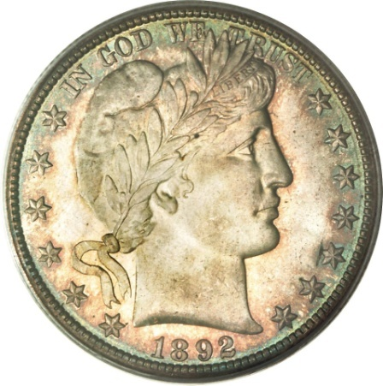
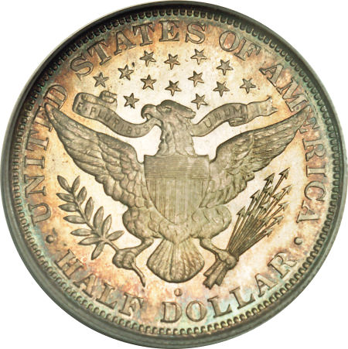
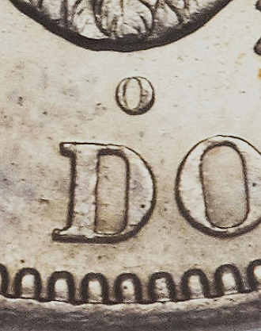
1892-O Micro O Half: Fact or Fiction?
Notes:
This presentation discusses an unusual question that was brought up at a coin show about the most famous Barber variety, the 1892-O Micro O half. And the investigation that followed…

Slide 2
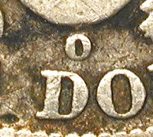
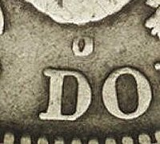
The coin
Discovery first mentioned in 1893
Known number of specimens estimated in 36-55 range
Assumed caused by mintmark punch intended for the quarter
Die must have been pulled from use quickly after error was discovered, accounting for so few known
Most examples are known in either low grades or high grades, with few in middle grades
Notes:
First of all, let’s talk about the Micro O half…
It’s been known for a long time, over 100 years for certain, and it is possible that it was discovered by numismatists as early as 1893.
It is rare, as there are only several dozen known, perhaps in the 40-55 range, and possibly a few more than that.
The assumption that has always been made was the accidental use of a O mintmark punch intended for the quarter rather than the half dollar. It is the same size as the Barber quarter mintmark.
Because there are so few examples known, and the fact that the small size is so obvious even without the use of a magnifier, the coiner must have noticed the problem early in the production run and pulled the die from use, and replaced it with one with a normal mintmark size.
Consistent with the 1892-O Barber Half as a date, most known Micro O coins are in very low grade (AG-VG) or near or in Mint State, with few examples in middle grades.

Slide 3
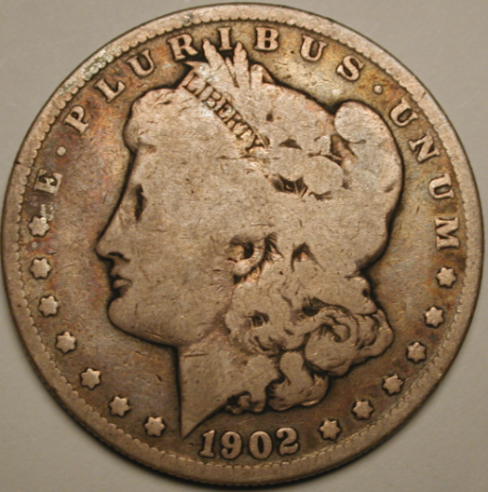
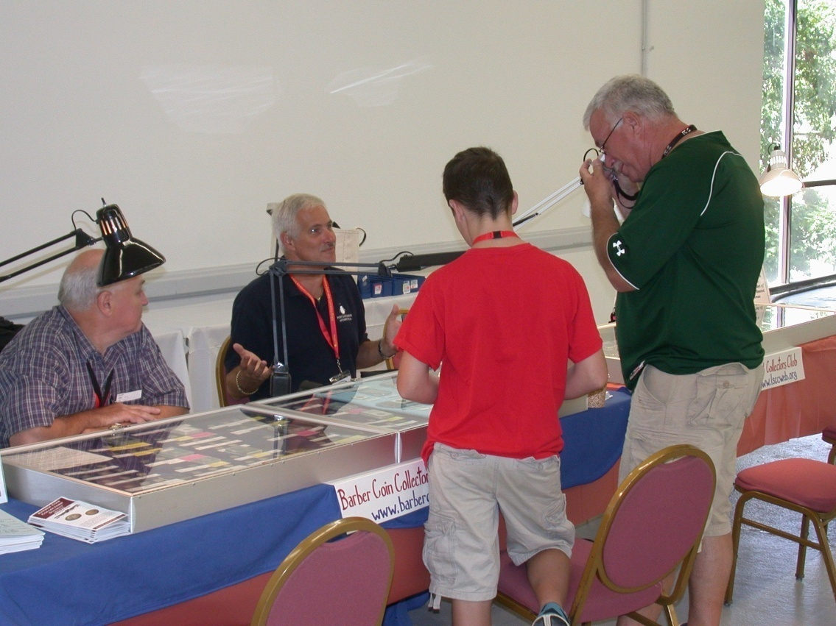
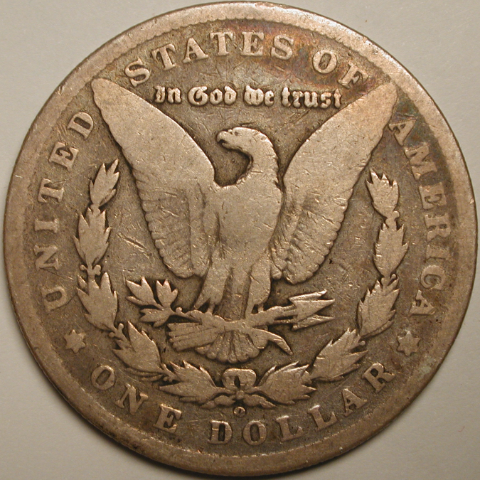
An interesting perspective… Manchester NH Coin Expo
Two visitors referred to the recent delisting of 3 “Small O” Morgan Dollars, now deemed counterfeit
Counterfeit 1902-O dollar
page 3
Notes:
An interesting thing happened at the New Hampshire Coin Expo a few years ago. A couple of collectors stopped by the BCCS table and examined a Micro O half on exhibit.
They said they questioned whether the Micro O half was a legitimate variety, or a counterfeit. They referred to the three “Small O” Morgan dollar issues that were known for years, but recently declared to be counterfeits. Many of those dollars were certified and encapsulated by the major grading services, only to be deemed fakes.
They wondered whether a similar thing could happen with the Micro O half, assumed to the real thing and in the future declared fakes.
Being an entirely different situation and denomination, we asked why they had doubts about the Micro O half.

Slide 4
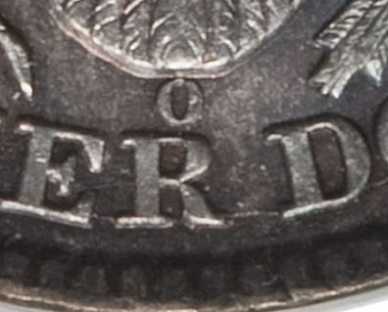
Their doubt about the 1892-O
They noted
The Micro O Half has a small asymmetrical mintmark
The 1892-O quarter has a symmetrical mintmark
Therefore…they wondered…
Perhaps like the dollars, the variety is a forgery
After all, both known for many decades
Perhaps PCGS/NGC will also declare counterfeit in the future
Notes:
First, they noted that the Micro O half has a mintmark that is not symmetrical in form, with the right side of the O being heavier than the left side,
They had tested the assumption that a Quarter mintmark punch was used, and discovered the 1892-O Barber Quarter has a symmetrical mintmark, unlike that seen on the Micro O half.
Thus, because the two didn’t match, they suspected it might be a well executed counterfeit.
And if this is a possibility, isn’t it also possible that someday the grading services will declare these counterfeits? After all, the Small O Morgan dollars were known for decades before being declared fakes.
They wouldn’t want to spend thousands of dollars on a counterfeit.

Slide 5
Other considerations
The 3 bogus Morgan VAMs don’t exist in high grades
Certainly no gems
Probably no known uncirculated examples
Vast majority exist in G-VF
The 1892-O Micro O half has a number of MS coins, and a number of gems (up to MS68)
Could not have been counterfeited to this level of quality 100 years ago – had to be a mint product…
Notes:
There were some big differences between the situation involving the Morgan Dollars and the Micro O half.
First of all, all of the known Small O Morgan dollars were in lower grades, with no known mint state examples, and certainly no gems. The majority exist in G-VF grades.
Unlike the dollars the Micro O half is known with several in gem condition, with the finest known example being the MS68 coin in the Eliasburg collection.
The other thing is that it would be impossible to have manufactured these high-quality counterfeits over 100 years ago. Thus, this had to be a mint product.
But still, the asymmetrical mintmark hasn’t been explained as it doesn’t match the normal 1892-O Quarter mintmark.

Slide 6
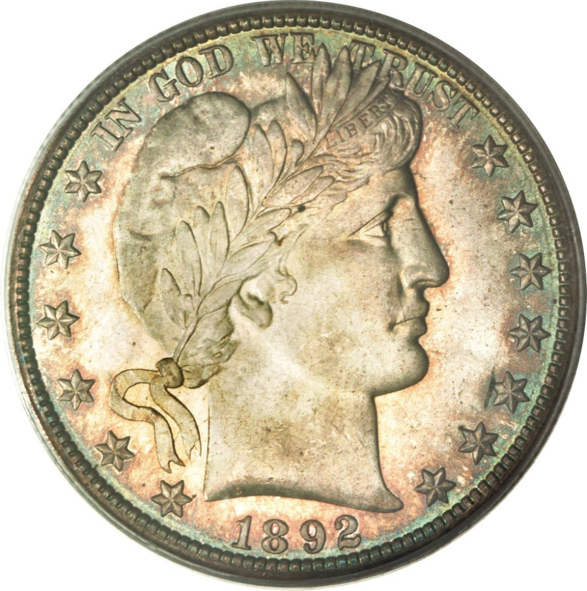
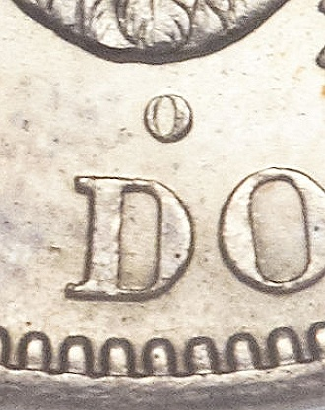
No way this is counterfeit!
Still, how to explain the mintmark discrepancy?
page 6
Notes:
ANIMATED SLIDE
So, how can the discrepancy in the mintmarks be explained?
Without some tangible explanation, the skeptics were not to be convinced.

Slide 7
Research needed
??? Die chip?
Not likely
??? Uneven punch into die?
Task:
Find another coin where the same asymmetrical, same-sized mintmark punch was used
Or at least find another coin with a mintmark that looks like this
Notes:
So, so research into alternative explanations would need to be performed.
Some initial thoughts began with the idea of the heavy side of the mintmark being the result of a die chip. But this is very unlikely because of the smooth curve, rather than something straight or irregular.
Could the Quarter mintmark have been punched into the half dollar die at an angle, resulting in an uneven appearance? Possibly!
Therefore, a search was conducted to find another coin could be found with the same-size mintmark with an asymmetrical appearance, or at the very least, find another coin with a similar-looking mintmark.

Slide 8
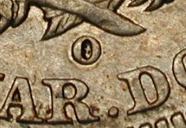
Look at another quarter - 1891-O
Mintmark too large and not asymmetrical
Notes:
ANIMATED SLIDE
Using a series of photos (all scaled to the same size), the Micro O mintmark, and the 1892-O quarter mintmark (symmetrical) and other denominations are compared to see if there is match.
First examined was the mintmark of the 1891-O Liberty Seated quarter that was just minted the prior year.
However, as is evident, the mintmark of the 1891-O quarter was too large and it was not asymmetrical

Slide 9
Other denominations
Perhaps other denominations used the same size mintmark?
Dime: no, larger than the quarter (1905-O Micro O)
Dollar: no, larger than the quarter (genuine1880-O, 1899-O Small O coins)
This leaves gold
Gold dollar: no – last O-mint was 1856
Quarter Eagle: no – last O-mint was 1856
3-Dollar: no – only in 1854, and large O at that
Double Eagle: no – last issued in 1879
Notes:
Because that didn’t match either, perhaps the mintmark punch for something other than a quarter was used, either from another silver coin, or even from a gold coin denomination?
Looking at all of the possibilities, we can eliminate many of them right off the bat:
- The Barber dime actually used a much larger mintmark than the quarter, so that isn’t a possibility
- The Morgan dollar used a larger O mintmark punch, including the remaining genuine “small O” coins, which are the 1880-O and 1899-O, so this can’t be the answer either.
Moving to gold coins, some of the denominations had not been minted in New Orleans for decades
- Gold dollar last O coin was in 1856
- Quarter Eagle last O mint also was in 1856
- The $3 gold coin was only minted in New Orleans in 1854, and it was a large O at that, so that can’t be it
- The $20 double eagle, since the Civil War, was only minted in 1879, so that isn’t it either.
This leaves the Half Eagle and the Eagle…

Slide 10
Comparing with the Half Eagle
Mintmark is tall and narrow, recently replacing the round O
Notes:
The O mintmark punch for the Liberty half eagle provided the gold coin with a tall and narrow mintmark, so that isn’t it.
The previous style mintmark style for the half eagle that had been recently replaced was indeed round in shape, but too large.

Slide 11
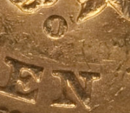
Comparing with the Eagle
Mintmark is too large, and yes, symmetrical
Simply put, no other denomination could be the source of this mintmark punch
page 11
Notes:
ANIMATED SLIDE
The mintmark style for the Eagle was a round O, but it is both too large and also it was symmetrical as well.
The conclusion: no other denomination’s mintmark punch could possibly create the mintmark found on the Micro O half. The Quarter was indeed the only realistic possibility.
The asymmetrical nature of the mintmark is the only difficulty.

Slide 12
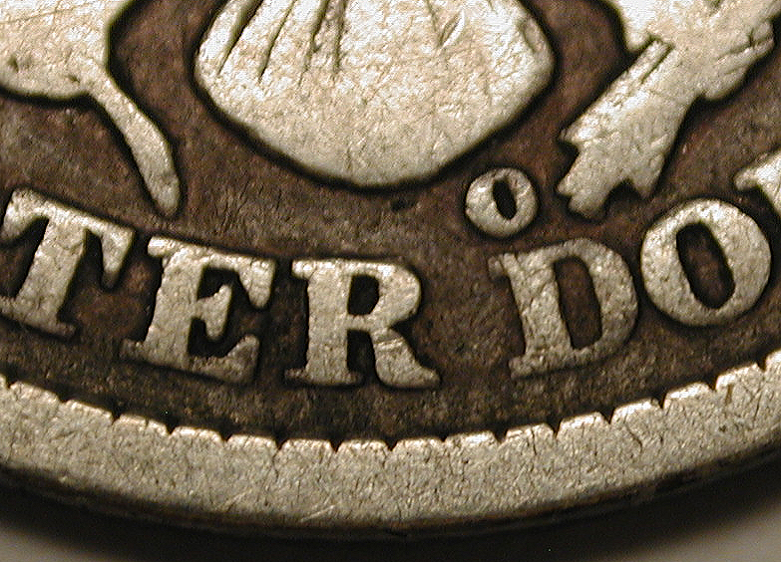
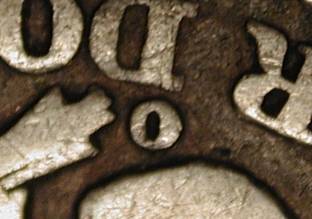
If the year before (1891-O) was examined…
Why not examine the year after?
1893-O
Same size & shape, but inverted
Bingo!
page 12
Notes:
ANIMATED SLIDE
Then another thought occurred…
We had looked at quarters from 1892-O for comparison, and also the year before, 1891-O. Perhaps the year after, 1893-O, should also be examined.
A large pile of low-grade Barber quarters that were purchased as 90% silver bullion were examined, with special attention paid to 1893-O coins.
Most of the coins had the normal symmetrical mintmark, but finally one appeared with a mintmark that had a heavy left side, much thicker than the right side. Asymmetrical!
A simple flip over of the image and you get a very similar look that is found on the Micro O half!
Finally a match! The investigation was complete, and it proved that a quarter mintmark punch could produce an asymmetrical mintmark as shown on the Micro O half.

Slide 13
Summary
The known Gem specimens tell us they simply had to be a U.S. Mint issue
The only hitch was the existence of that particular mintmark only on the 1892-O Micro O half, and not on any other coin
Needed a way to explain the different mintmark shape, not just the size
To put this to rest, another coin had to be found with a similar appearance
We’ve found one!
Notes:
To summarize…
The gem examples that have been known for over 100 years let us know that these had to be genuine, because counterfeiting to this level of quality simply was not possible at the time. MS65-68 coins tell us that the variety is legitimate
The only problem was explaining the asymmetrical mintmark on the Micro O half when it wasn’t found on the 1892-O quarters, which supposedly used the same size mintmark punch
We needed to find a way to explain the different shape to the mintmark, and not just the size
To prove it to everyone’s satisfaction, a different coin had to be found with a similar-looking mintmark, both size and shape
Investigation proved that other denomination mintmark punches were not the answer, and after looking at a lot of different coins, we found one on a lower-grade 1893-O quarter.

Slide 14
The only conclusion…
1892-O Micro O Barber Half
Fact or Fiction?
FACT!
page 14
Notes:
Thus, the only possible conclusion to the question
“1892-O Micro O Barber Half, fact or fiction?”
ANIMATED SLIDE
Fact!

Slide 15
Thank you! Questions?

